Slide 1
Core java day11
NEEHARIKA

Slide 2
Life cycle of a Thread
In Java, a thread always exists in any one of the following states. These states are:
New
Active
Blocked / Waiting
Timed Waiting
Terminated

Slide 3
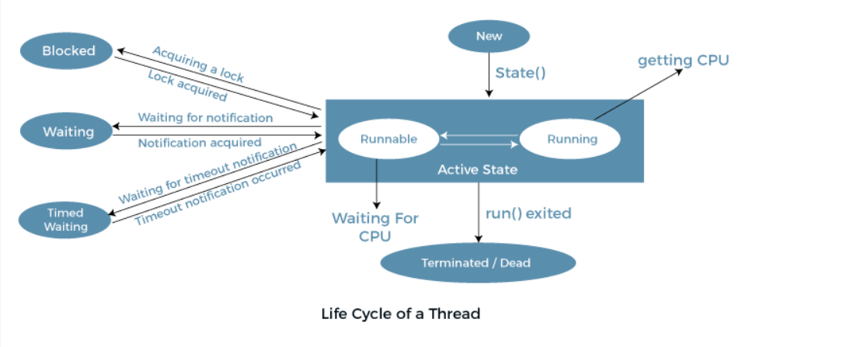

Slide 4
Implementation of Thread States
public static final Thread.State NEW
public static final Thread.State RUNNABLE
public static final Thread.State BLOCKED
public static final Thread.State WAITING
public static final Thread.State TIMED_WAITING
public static final Thread.State TERMINATED

Slide 5
Daemon Thread in Java
Daemon thread in Java is a service provider thread that provides services to the user thread. Its life depend on the mercy of user threads i.e. when all the user threads dies, JVM terminates this thread automatically.

Slide 6
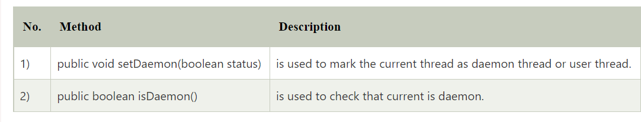
Methods for Java Daemon thread by Thread class

Slide 7
Simple example of Daemon thread in java

Slide 8
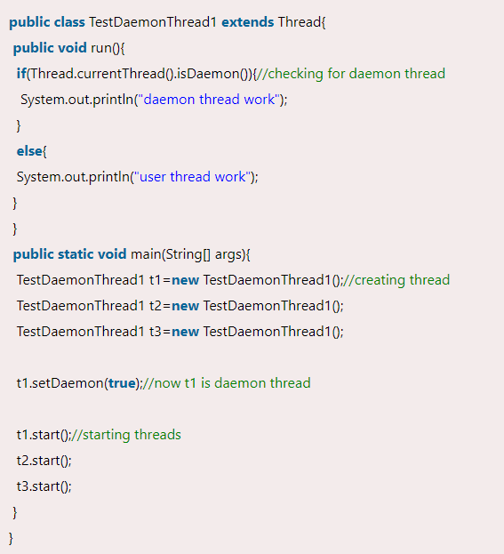

Slide 9
Priority of a Thread (Thread Priority)
Each thread has a priority. Priorities are represented by a number between 1 and 10. In most cases, the thread scheduler schedules the threads according to their priority (known as preemptive scheduling).

Slide 10
Setter & Getter Method of Thread Priority
public final int getPriority()
public final void setPriority(int newPriority)

Slide 11
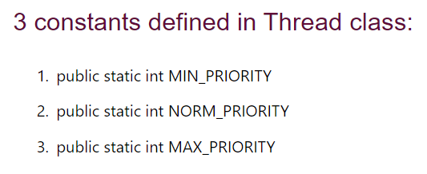

Slide 12
Synchronization in Java
Synchronization in Java is the capability to control the access of multiple threads to any shared resource.

Slide 13
Types of Synchronization
Process Synchronization
Thread Synchronization

Slide 14
Thread Synchronization
Mutual Exclusive
Synchronized method.
Synchronized block.
Static synchronization.
Cooperation (Inter-thread communication in java)

Slide 15
Mutual Exclusive
By Using Synchronized Method
By Using Synchronized Block
By Using Static Synchronization

Slide 16
Concept of Lock in Java

Slide 17
Inter-thread Communication in Java
wait()
notify()
notifyAll()

Slide 18
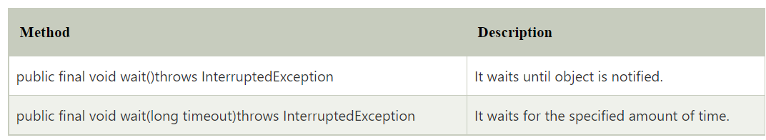
wait() method

Slide 19
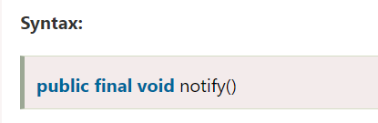
notify() method

Slide 20
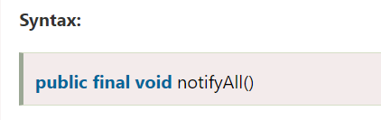
notifyAll() method

Slide 21
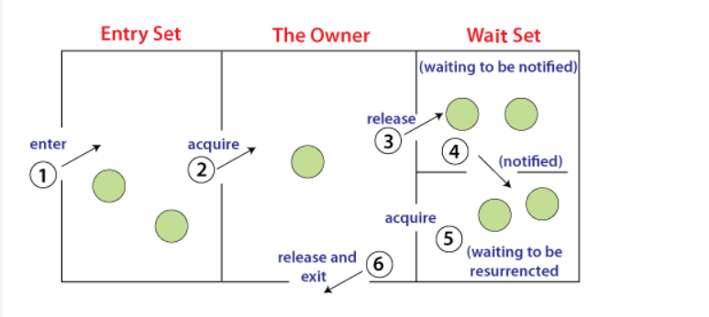

Slide 22
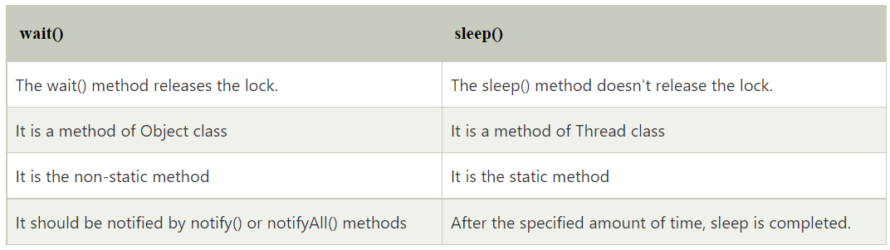
Difference between wait and sleep?

Slide 23
Collections in Java
The Collection in Java is a framework that provides an architecture to store and manipulate the group of objects.

Slide 24
What is Collection in Java
A Collection represents a single unit of objects, i.e., a group.

Slide 25
What is a framework in Java
It provides readymade architecture.
It represents a set of classes and interfaces.
It is optional.

Slide 26
What is Collection framework
Interfaces and its implementations, i.e., classes
Algorithm

Slide 27
Java Collection Interface
Collection is a group of objects, which are known as elements. It is the root interface in the collection hierarchy. This interface is basically used to pass around the collections and manipulate them where the maximum generality is desired.

Slide 28
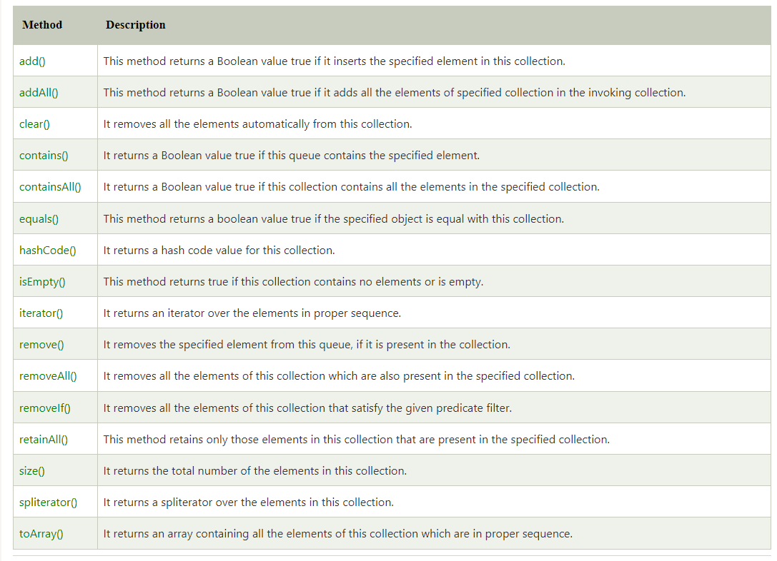

Slide 29
Iterator in Java
The Java Iterator is also known as the universal cursor of Java as it is appropriate for all the classes of the Collection framework. The Java Iterator also helps in the operations like READ and REMOVE. When we compare the Java Iterator interface with the enumeration iterator interface, we can say that the names of the methods available in Java Iterator are more precise and straightforward to use.

Slide 30
Advantages of Java Iterator
The user can apply these iterators to any of the classes of the Collection framework.
In Java Iterator, we can use both of the read and remove operations.
If a user is working with a for loop, they cannot modernize(add/remove) the Collection, whereas, if they use the Java Iterator, they can simply update the Collection.
The Java Iterator is considered the Universal Cursor for the Collection API.
The method names in the Java Iterator are very easy and are very simple to use.

Slide 31
Disadvantages of Java Iterator
The Java Iterator only preserves the iteration in the forward direction. In simple words, the Java Iterator is a uni-directional Iterator.
The replacement and extension of a new component are not approved by the Java Iterator.
In CRUD Operations, the Java Iterator does not hold the various operations like CREATE and UPDATE.
In comparison with the Spliterator, Java Iterator does not support traversing elements in the parallel pattern which implies that Java Iterator supports only Sequential iteration.
In comparison with the Spliterator, Java Iterator does not support more reliable execution to traverse the bulk volume of data.

Slide 32
Java Iterator Methods
hasNext()
next()
remove()
forEachRemaining()

Slide 33
Load Factor in HashMap
Initial Capacity
Load Factor

Slide 35
Load Factor
The Load factor is a measure that decides when to increase the HashMap capacity to maintain the get() and put() operation complexity of O(1). The default load factor of HashMap is 0.75f (75% of the map size).

Slide 36
Hierarchy of Collection Framework

Slide 37
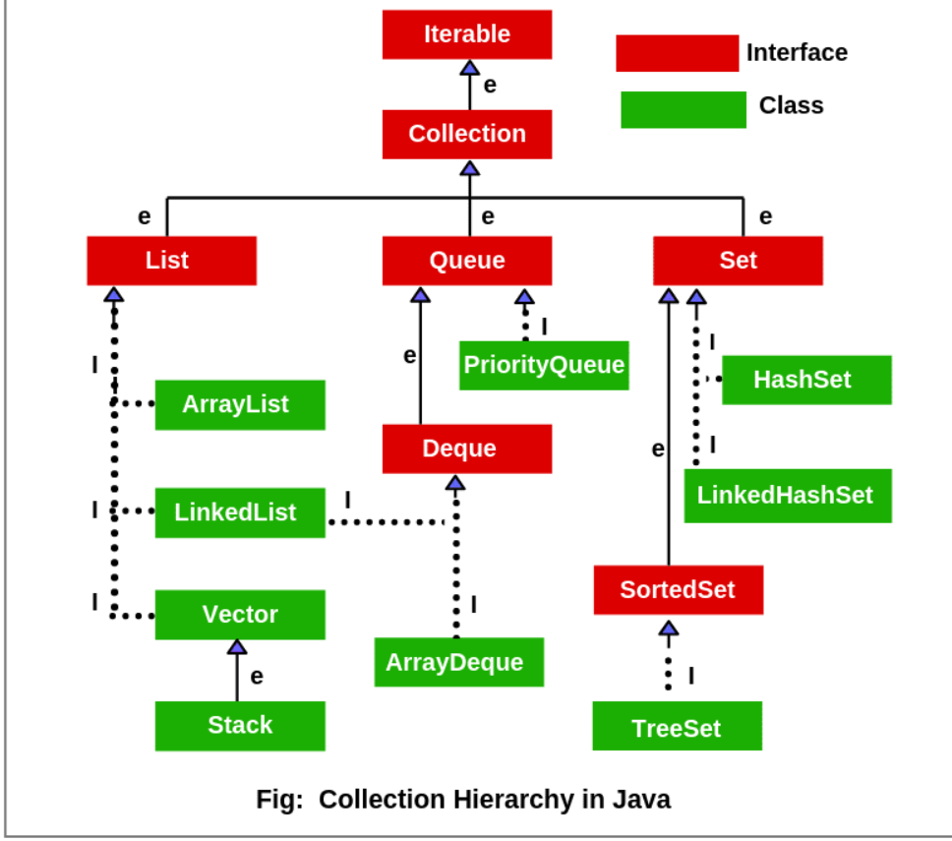

Slide 38
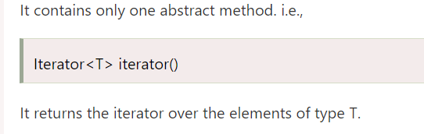
Iterable Interface

Slide 39
Collection Interface
The Collection interface is the interface which is implemented by all the classes in the collection framework. It declares the methods that every collection will have. In other words, we can say that the Collection interface builds the foundation on which the collection framework depends.

Slide 40
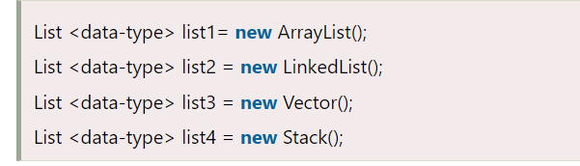
List Interface

Slide 41
ArrayList
The ArrayList class implements the List interface. It uses a dynamic array to store the duplicate element of different data types. The ArrayList class maintains the insertion order and is non-synchronized.

Slide 42
LinkedList
LinkedList implements the Collection interface. It uses a doubly linked list internally to store the elements. It can store the duplicate elements. It maintains the insertion order and is not synchronized

Slide 43
Vector
Vector uses a dynamic array to store the data elements. It is similar to ArrayList. However, It is synchronized and contains many methods that are not the part of Collection framework.

Slide 44
Stack
The stack is the subclass of Vector. It implements the last-in-first-out data structure, i.e., Stack. The stack contains all of the methods of Vector class and also provides its methods like boolean push(), boolean peek(), boolean push(object o), which defines its properties.

Slide 45
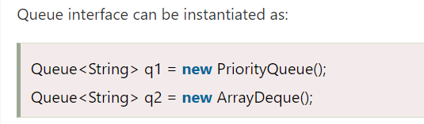
Queue Interface

Slide 46
Priority Queue
The PriorityQueue class implements the Queue interface. It holds the elements or objects which are to be processed by their priorities. PriorityQueue doesn't allow null values to be stored in the queue.

Slide 47
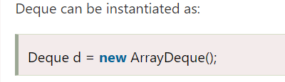
Deque Interface

Slide 48
Array Deque
ArrayDeque class implements the Deque interface. It facilitates us to use the Deque. Unlike queue, we can add or delete the elements from both the ends.
ArrayDeque is faster than ArrayList and Stack and has no capacity restrictions.

Slide 49
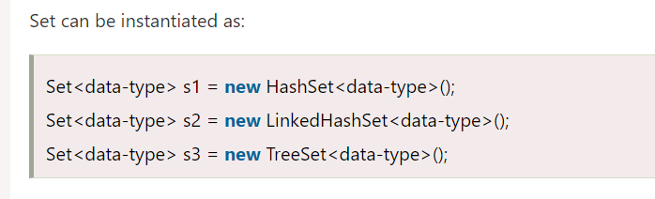
Set Interface

Slide 50

Hashing Techniques in Java

Slide 51
What is Hashing
It is the process of converting an object into an integer value. The integer value helps in indexing and faster searches.

Slide 52
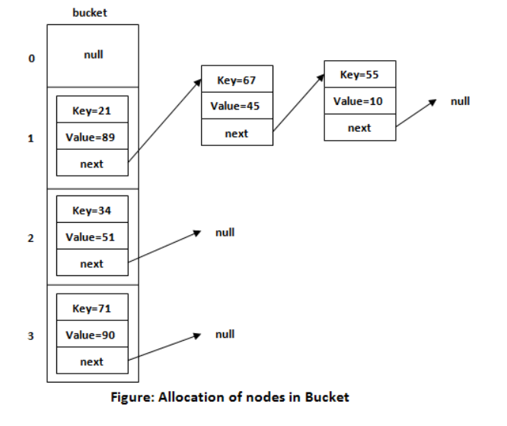

Slide 53

Hash Collision

Slide 54
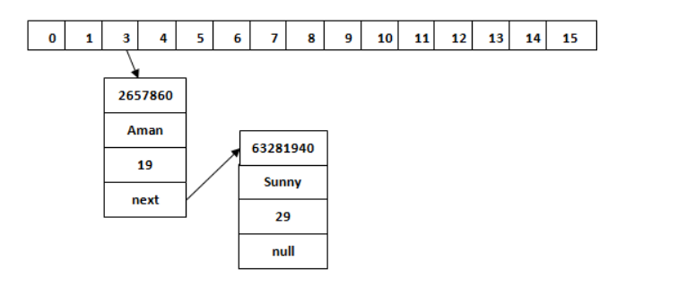

Slide 55
Methods for Implementing hashing in Java
HashTable-based Method(A synchronised implementation of hashing)
2. HashMap-based Method (A non-synchronized faster implementation of hashing)
3. LinkedHashMap-based method(Similar to HashMap, but keeps order of elements)
4. ConcurretHashMap-based Method (Similar to HashTable, Synchronized, but faster as multiple locks are used)

Slide 56
Hash Set
HashSet class implements Set Interface. It represents the collection that uses a hash table for storage. Hashing is used to store the elements in the HashSet. It contains unique items.

Slide 57
Linked Hash Set
LinkedHashSet class represents the LinkedList implementation of Set Interface. It extends the HashSet class and implements Set interface. Like HashSet, It also contains unique elements. It maintains the insertion order and permits null elements.

Slide 58
Tree Set
Java TreeSet class implements the Set interface that uses a tree for storage. Like HashSet, TreeSet also contains unique elements. However, the access and retrieval time of TreeSet is quite fast. The elements in TreeSet stored in ascending order.

Slide 59
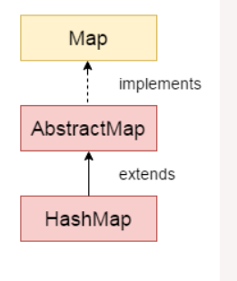
Java HashMap

Slide 60
HashMap class declaration
public class HashMap<K,V> extends AbstractMap<K,V> implements Map<K,V>, Cloneable, Serializable

Slide 61
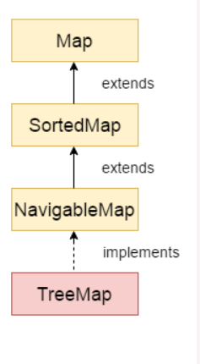
Java TreeMap class

Slide 62
TreeMap class declaration
public class TreeMap<K,V> extends AbstractMap<K,V> implements NavigableMap<K,V>, Cloneable, Serializable

Slide 63
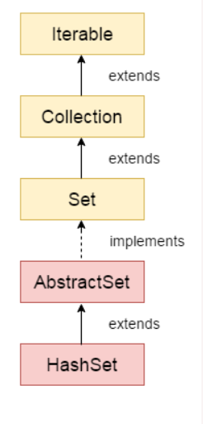
Java HashSet

Slide 64
HashSet class declaration
public class HashSet<E> extends AbstractSet<E> implements Set<E>, Cloneable, Serializable

Slide 65
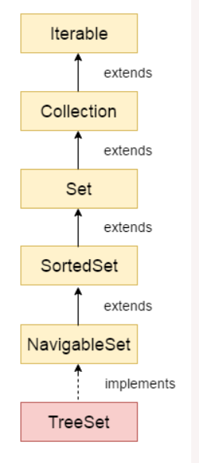
Java TreeSet class

Slide 66
TreeSet class declaration
public class TreeSet<E> extends AbstractSet<E> implements NavigableSet<E>, Cloneable, Serializable

Slide 67
Thank you

